Slide 1

Insider Threat Detection Using Elastic Net Regularized Logistic Regression
A Machine Learning Approach to Cybersecurity

Slide 2


What Are Insider Threats?
Authorized Users as Threats
Threats originating from employees, contractors, or partners with legitimate system access.
Hard to Detect
Malicious behavior closely resembles normal activity, making detection extremely difficult.
Severe Consequences
Data breaches, financial losses, and lasting reputational damage to organizations.

Slide 3
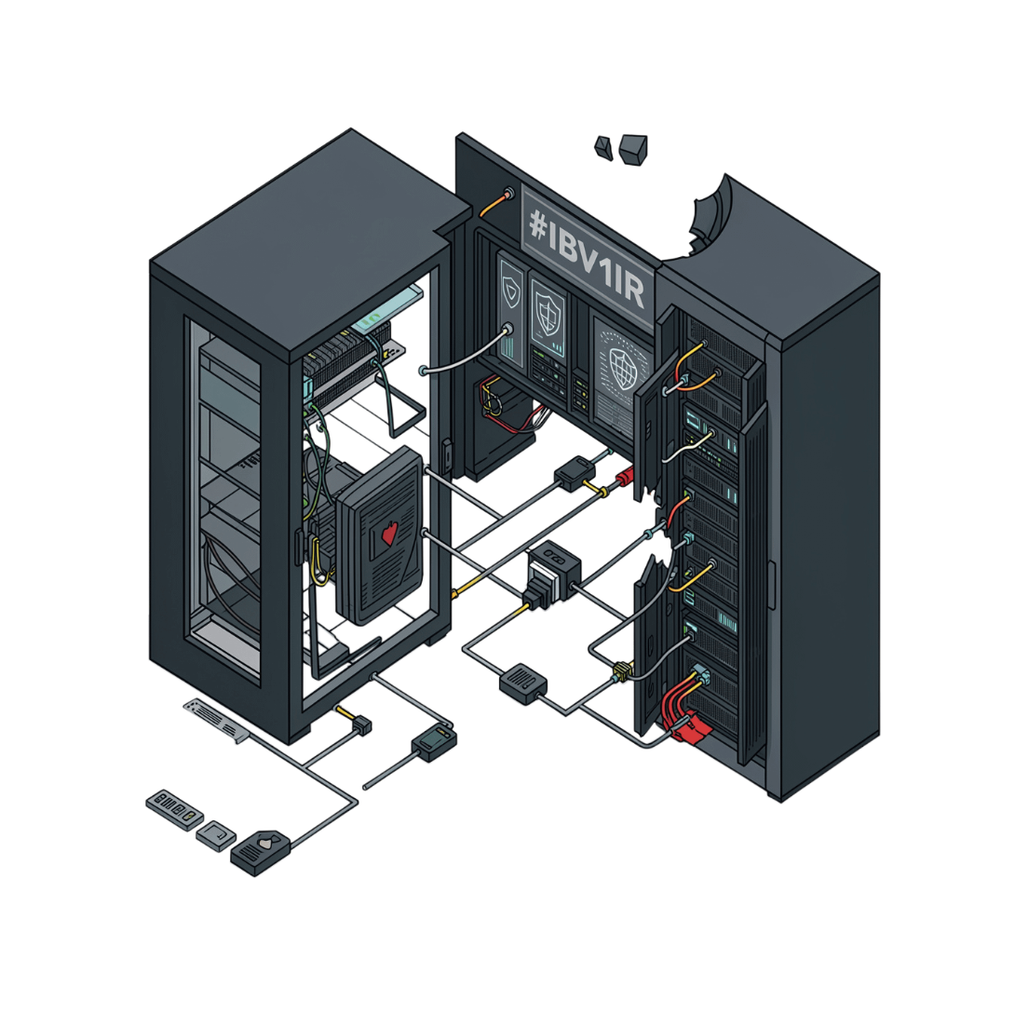
The Challenge
Why Traditional Systems Fall Short
Rule-based security systems were not designed to handle the complexity of human behavior. They rely on fixed thresholds and known patterns — but insider threats are dynamic, subtle, and constantly evolving.
Static rules cannot adapt to changing employee behavior
High false-positive rates overwhelm security teams
Intelligent, behavior-based detection is essential

Slide 4
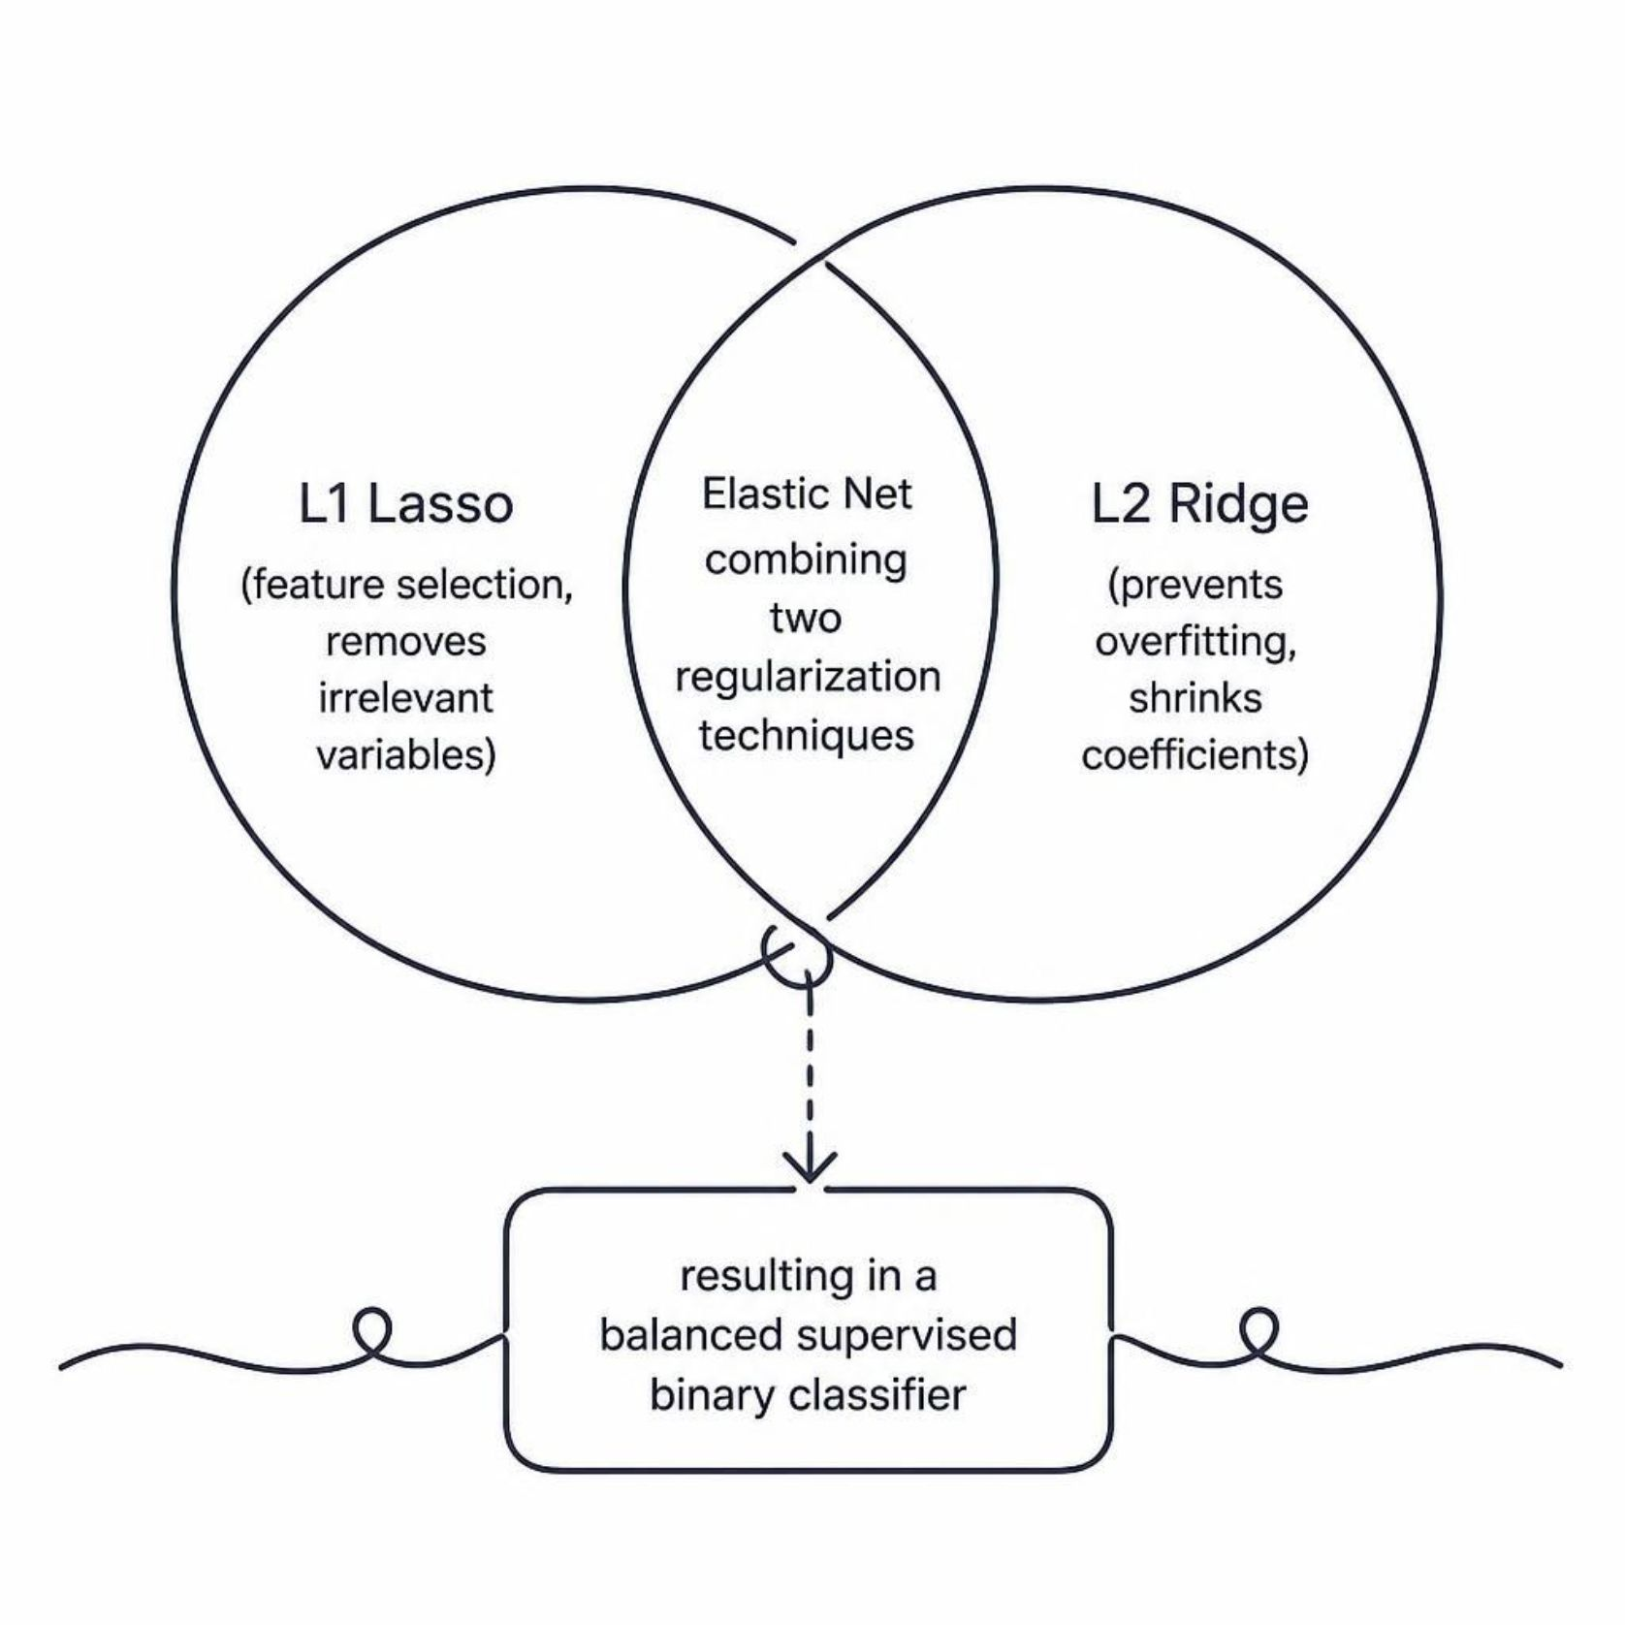
Our Solution: Elastic Net Regularized Logistic Regression
Why Elastic Net?
Elastic Net merges the strengths of two regularization strategies into one robust model.
L1 (Lasso): Selects only the most relevant behavioral features
L2 (Ridge): Reduces overfitting for greater generalization
Binary Classification: Labels users as normal or a potential insider threat

Slide 5




Data Analyzed
Login Patterns
File Access History
USB Device Usage
Email & Failed Logins
Timing, frequency, and location of user login activity.
Records of which files are accessed, modified, or downloaded.
Detection of external storage device connections and data transfers.
Suspicious email activity and repeated failed authentication attempts.

Slide 6

System Workflow
Model Training
Fit Elastic Net logistic model
Data Preprocessing
Classification
Handle missing values, encode, normalize
Label as Normal or Potential Insider
A structured end-to-end pipeline transforms raw employee activity logs into reliable threat classifications.

Slide 7
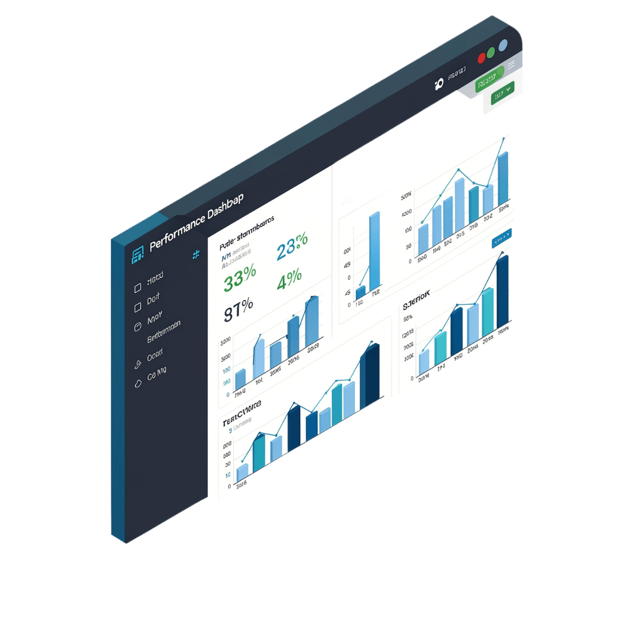
Performance Metrics
How We Evaluate the Model
A comprehensive set of metrics ensures the model is not only accurate but also fair and reliable across both threat and non-threat cases.
Accuracy: Overall correctness of predictions
Precision: How often flagged threats are truly malicious
Recall: How many actual threats are successfully caught
F1-Score: Balanced metric combining precision and recall
Confusion Matrix: Detailed breakdown of true/false positives and negatives

Slide 8
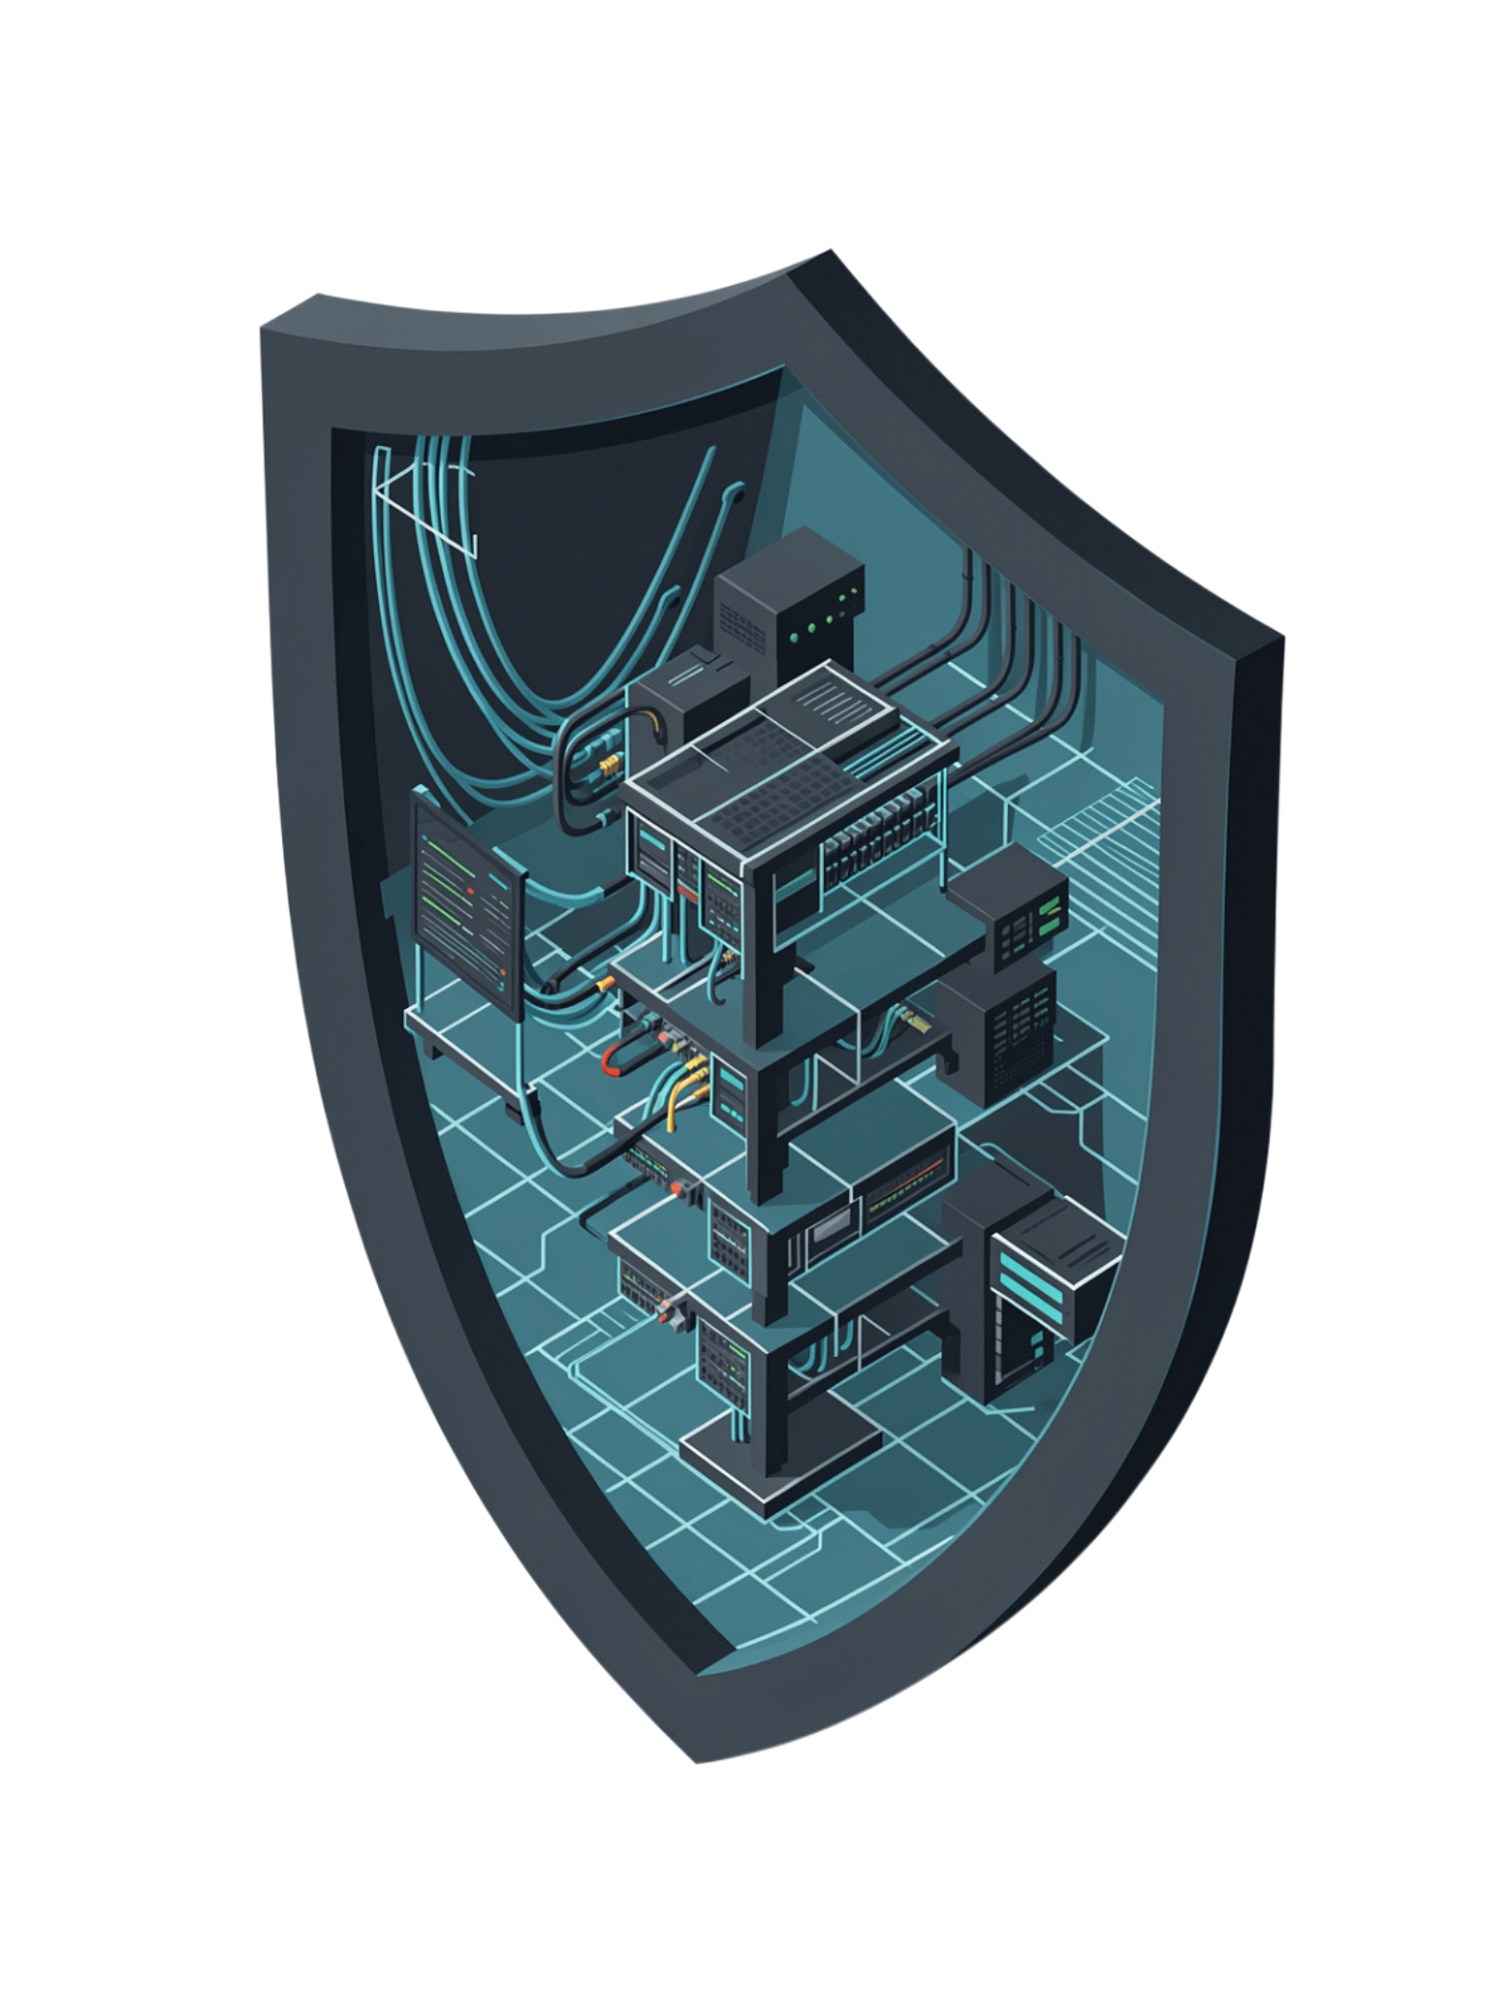
Key Benefits
Early Detection
Preventive Action
Identifies suspicious behavior before damage occurs, enabling timely intervention.
Empowers security teams to act proactively rather than reactively.
Scalable & Reliable
Efficient model architecture that scales with organizational growth.

Slide 9


Conclusion
Machine learning enhances cybersecurity by improving the efficiency, accuracy, and scalability of insider threat detection systems — protecting organizations from internal security risks.
The Elastic Net Regularized Logistic Regression model offers a principled, data-driven approach to a problem that traditional security systems cannot solve. By learning from behavioral patterns, it brings intelligence, adaptability, and precision to modern cybersecurity.
Behavior-based detection is the future of insider threat defense.

